Slide 1
Python Minecraft Coder Dojo
December 20, 2014
Class Kickoff

Slide 2
Agenda
1. Introductions
Mentors
2. Today’s Class
What are we going to learn?
4. Reference
What’s running where?
Getting connected
How does the class work?
Exercises
Students
3. Our Programming Environment
Useful URLs

Slide 3
Introductions
Mentors for today:
Mike McCallister
Nick LaMuro
Curtis Griesel
Nine students:
Name?
Grade?
Have you done this class before?
Questions for everyone:
What is your programming background?
What do you want to get out of today?

Slide 4
Today’s Class
What are we going to learn?
How to read, write, and run code in IPython
Basic Python syntax
How to change the Minecraft world using Python
How to have the Minecraft world trigger activity in Python
Anything else you want!

Slide 5
Today’s Class
How does the class work?
Get Connected
Pick an Exercise
Work On It
Completed?
Yes
All Done?
Yes
Claim the Reward!
No
No
Ground Rules
The one rule is...
Be cool by:
Helping each other. Check with other students before asking a mentor for help. “Ask three, then me.”
Learning Python. Today's focus is on programming, not the game. Remember, this is a Coder Dojo, not a LAN party!

Slide 6
Our Programming Environment
What is running where?
Server
python.coderdojotc.org
Your Laptop
Student Instance 1
Minecraft
Canary Server (Minecraft) python.coderdojotc.org:MC_PORT
Port
Port
Web Browser
Port
IPython Notebook Server
https://python.coderdojotc.org:IPY_PORT/
Port
Student Instance 2
Student Instance …

Slide 7
Our Programming Environment
Getting Connected
Talk to a Mentor.
Give your Mojang account name, or get a classroom account
Get your Connection Card:
Connect your PC to Wi-Fi.
Connect to your IPython Notebook session.
Connect to your Minecraft server.
Test the connection between Python and Minecraft.

Slide 8
Our Programming Environment
Step 2: Connect your PC to Wi-Fi:
General Wireless Configuration:
Connect to the “UofM Secure” SSID
Choose “WPA2-Enterprise” security
Choose “AES” encryption
Use the WiFi User and WiFi Password from your Connection Card
Details available at http://it.umn.edu/wifi-setup-guides

Slide 9
Our Programming Environment
Step 3: Connect to your IPython Notebook session:
Open your web browser: Chrome, Firefox, or IE 11
Enter the full URL of the IPython Address, including the “https” and the number at the end (“:18443” in the example below.
The browser will probably complain that it doesn’t trust the site. Proceed past the warnings.
Enter the IPython Password when prompted.

Slide 10
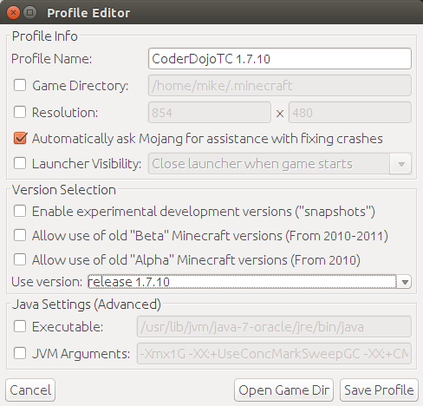
Our Programming Environment
Step 4: Connect to your Minecraft Server:
Launch Minecraft on your PC.
Create a profile and make sure it uses version 1.7.10 of the game (see right).
Click “Play” to launch the profile.
Choose “Multiplayer”
Then “Direct Connect”
In the Server Address field, enter the Minecraft Server address from your Connection Card, including the port number at the end.
Then click “Join Server”.

Slide 11
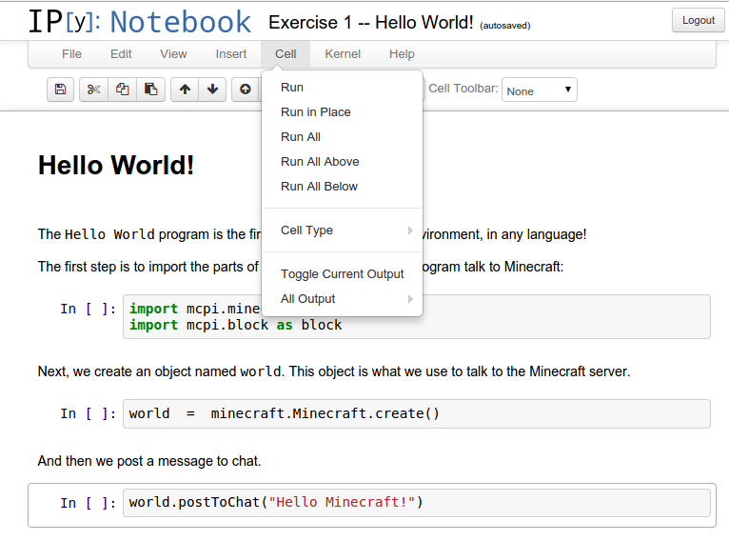
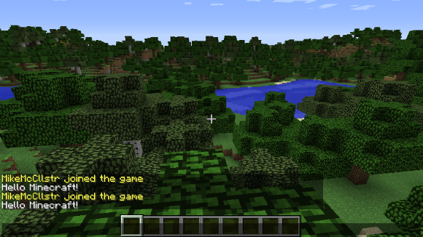
Our Programming Environment
Step 5: Test the connection between Python and Minecraft:
In IPython, click on “Exercise 1 – Hello World!” to open the notebook.
Choose Cell → Run All from the menu.
In the Minecraft game, look for the “Hello Minecraft!” message.

Slide 12
Reference
Exercises
Exercise 1: Hello World!
Exercise 2: Getting Started with IPython
Exercise 3: Basic Python Syntax
Exercise 4: Change the Minecraft world using Python
Exercise 5: Minecraft changes trigger activity in Python

Slide 13
Reference
Useful URLs:
Python docs:
Everything you could possibly want to know about Python.
https://docs.python.org/2/
Minecraft PI Worksheet:
A simple overview of programming Minecraft with Python.
https://docs.google.com/document/d/1gDoaiSKq6OOSk1GditlkGJnt8qdZ119eW67L-UTkFRI/edit?usp=sharing
Python Minecraft API:
A useful summary of all the things possible in the Python Minecraft API.
http://www.stuffaboutcode.com/p/minecraft-api-reference.html
Python cheat sheet:
A concise reference for some common Python syntax
http://www.cheatography.com/davechild/cheat-sheets/python/

